Slide 1
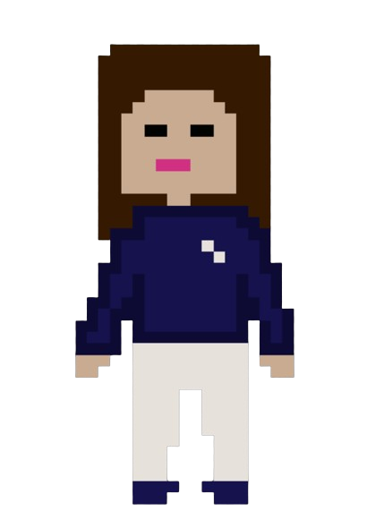
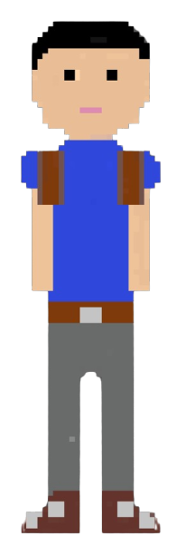


MISSION POSSIBLE
The harder you work for something, the greater you’ll feel when you achieve it

Slide 2

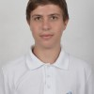


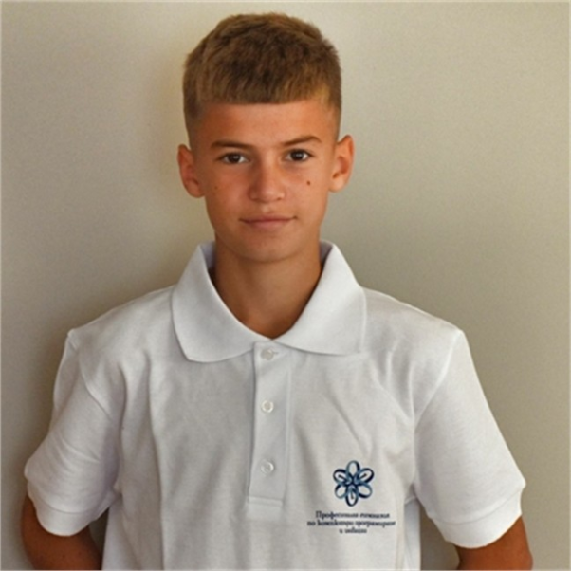

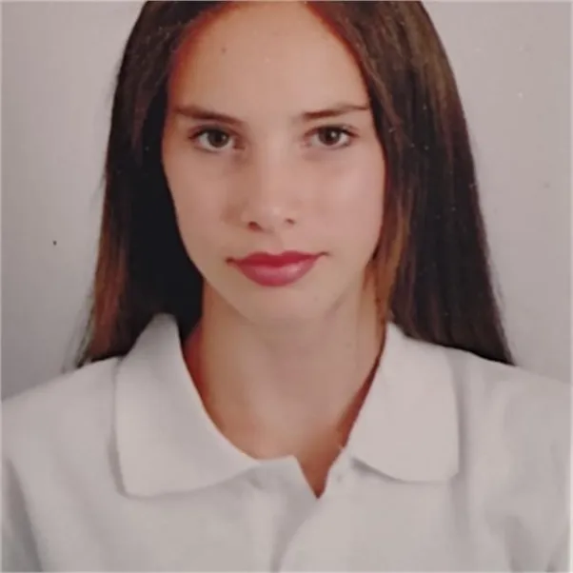



OUR
TEAM

Slide 3
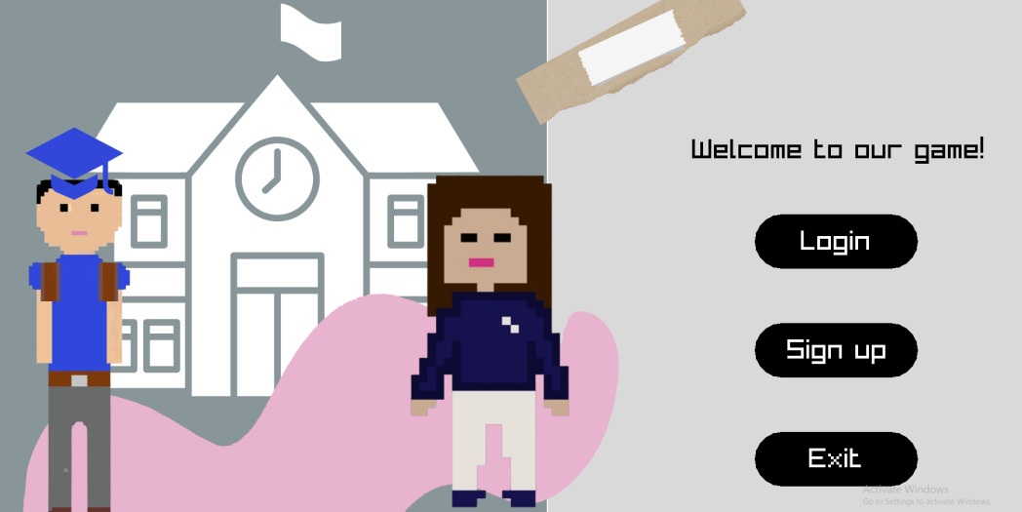


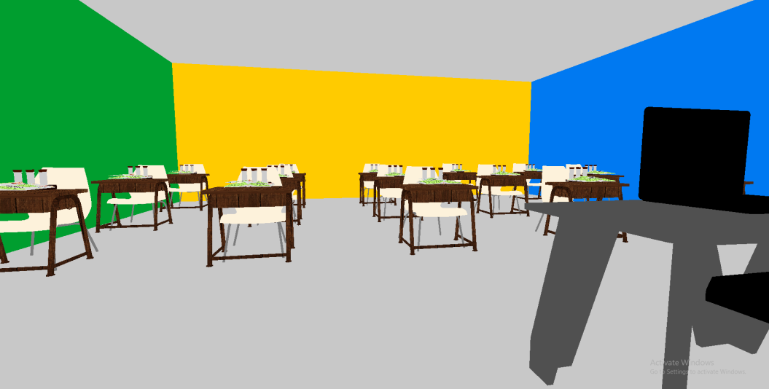
Our Idea
Our goal is to provide access to an easier and more interesting way to study the material. We have created an online environment as close to the real world as possible, where anyone can register and have their own account. After each test, you will be graded based on the knowledge you have demonstrated. Join our challenge!

Slide 4

STAGES OF DEVELOPMENT
FIRST WEEK
THIRD WEEK
SECOND WEEK
FOURTH WEEK
Creating logo and discussing ideas about the game
Developing the code
Making the design
and implementing our ideas through code
Creating the documentation and presentation

Slide 5








USED TECHNOLOGIES
 | Week 1 | Week 2 | Week 3 | Week 4

Slide 6


LET’S MOVE TO THE DEMONSTRATION!

